Slide 1
GitHub Actions
Lecturer: Ngo Huy Bien
Software Engineering Department
Faculty of Information Technology
VNUHCM - University of Science
Ho Chi Minh City, Vietnam
nhbien@fit.hcmus.edu.vn

Slide 2

Objectives
To implement continuous integration using GitHub Actions.

Slide 3

Contents
GitHub Actions.

Slide 4

References
Ashley Davis (2024). Bootstrapping Microservices with Docker, Kubernetes, GitHub Actions, and Terraform. Manning Publications.

Slide 5
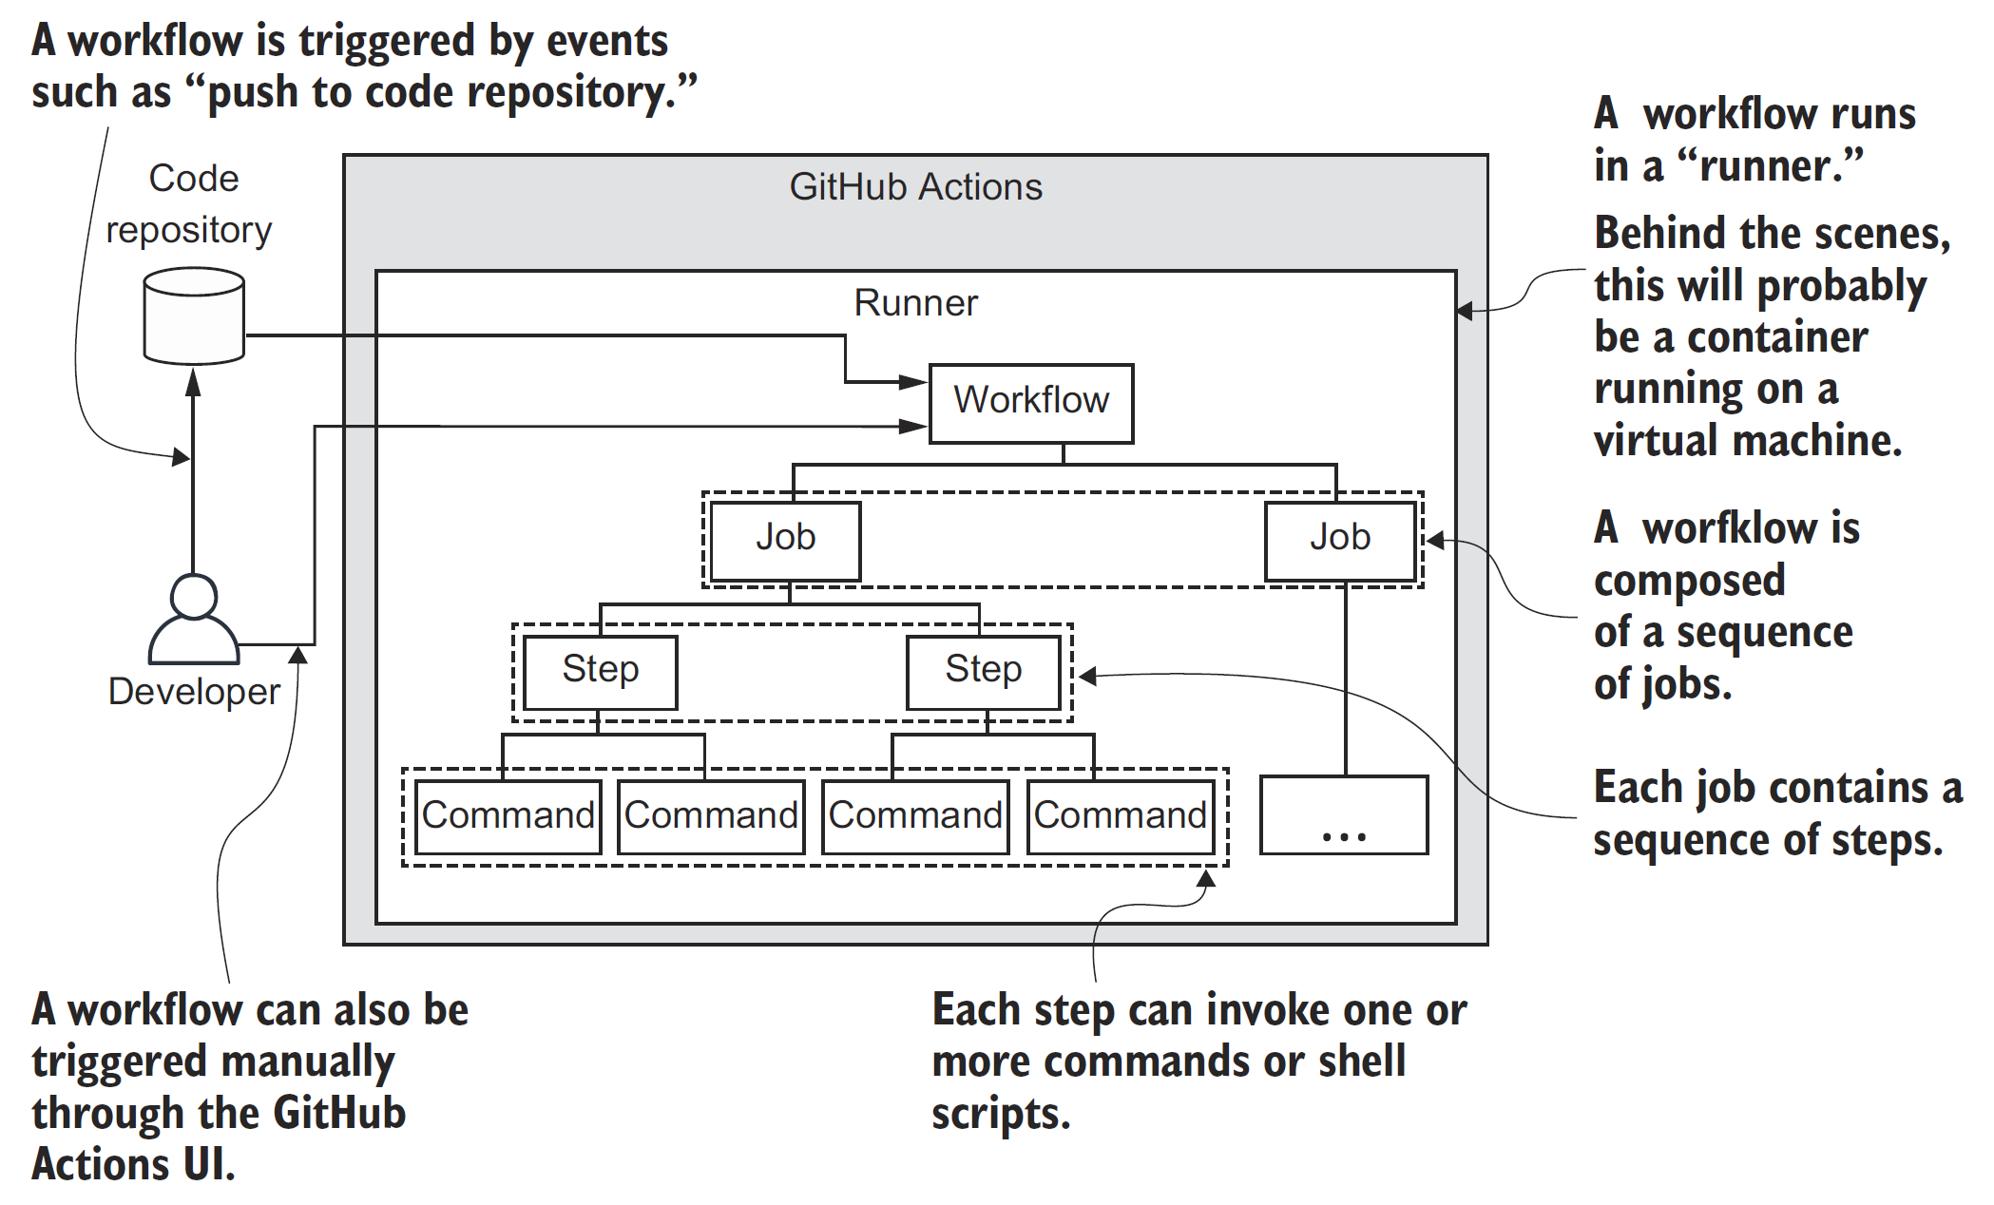
GitHub Actions Workflow [1]

Slide 6
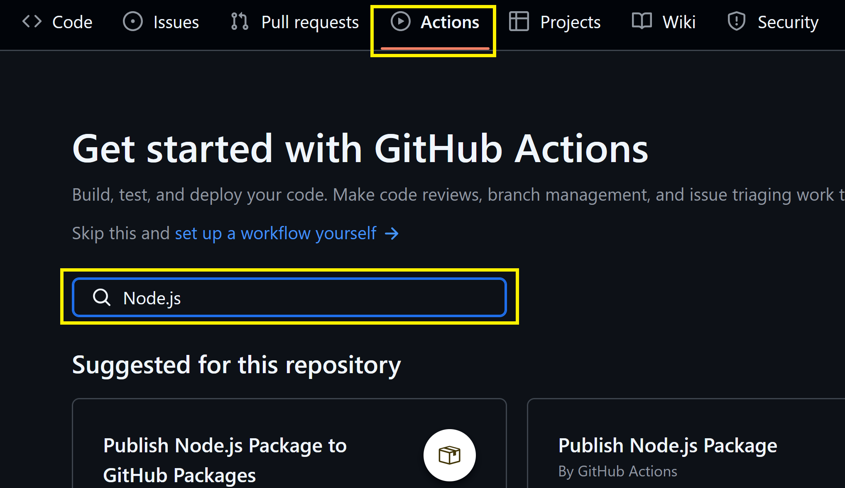
1. Open GitHub Actions
Register a GitHub account
Create a Node.js project with an empty test.

Slide 7
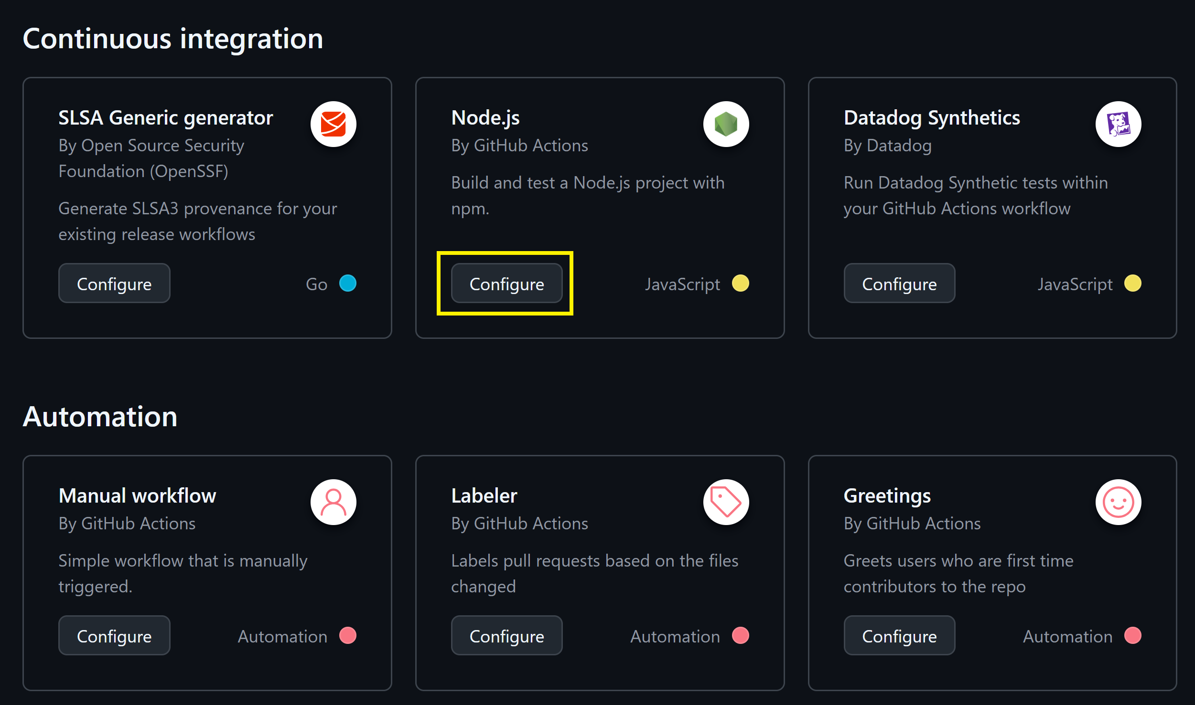
2. Create a new Workflow

Slide 8
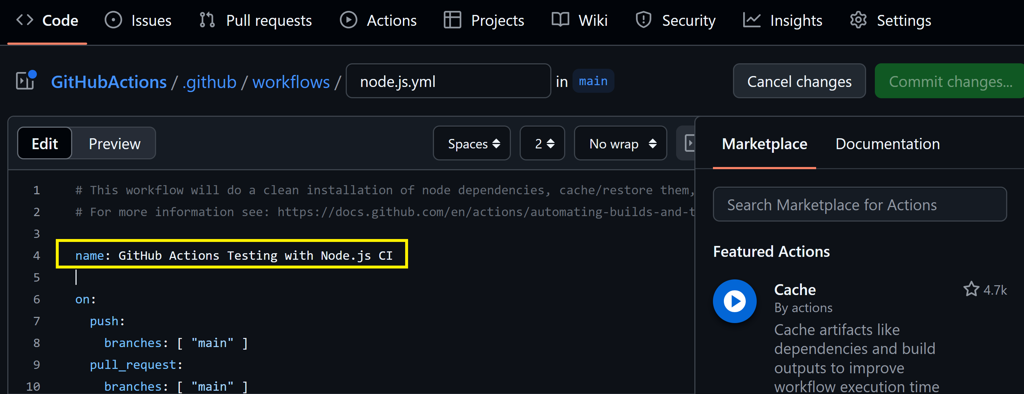
3. Modify the Workflow

Slide 9
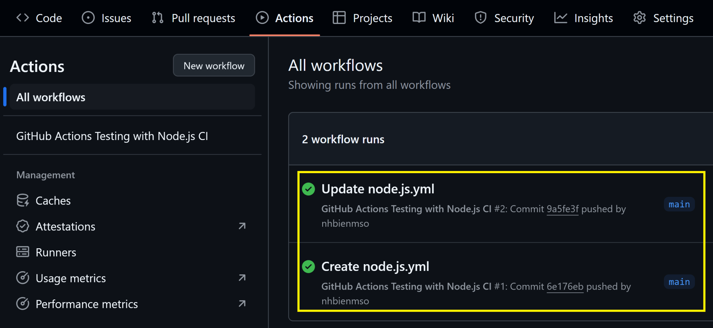
4. Review Workflow Runs

Slide 10
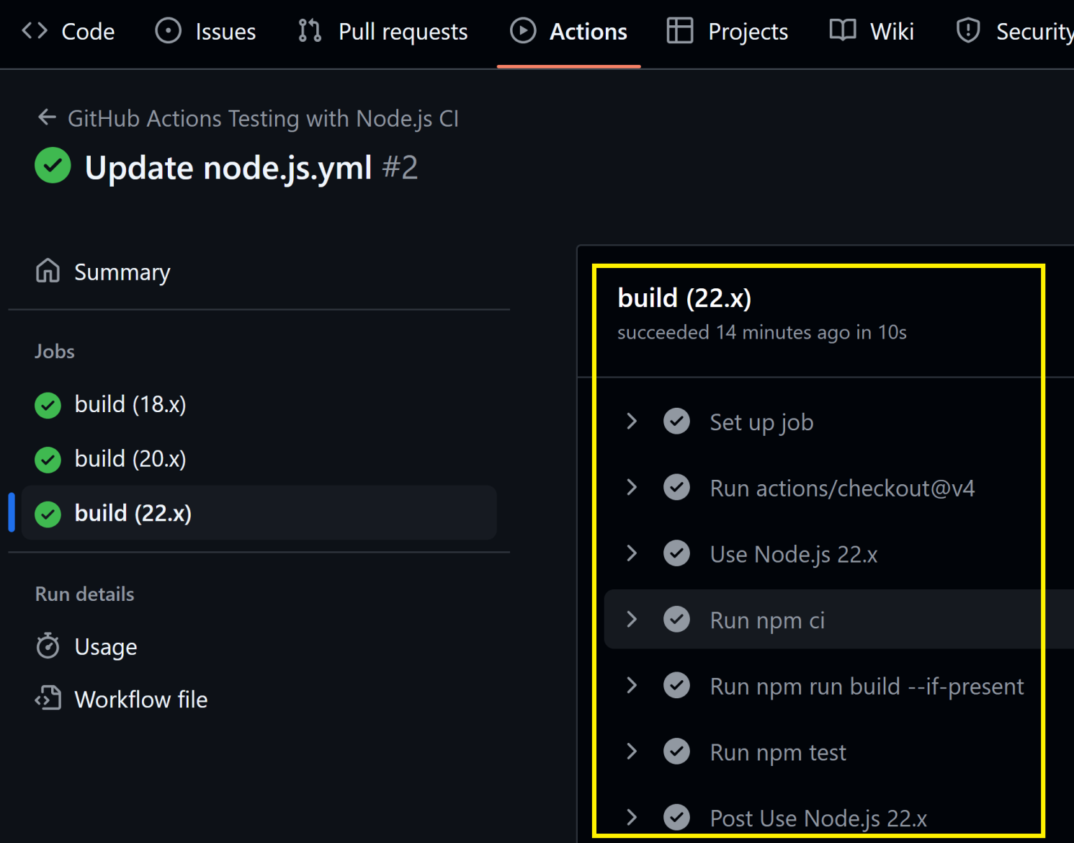
5. View Job Details

Slide 11


Slide 12
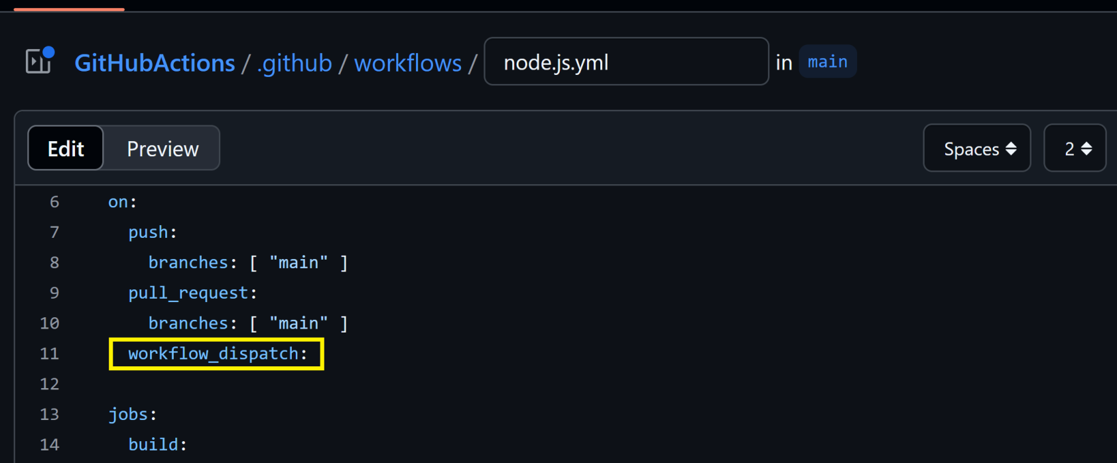
1. Enable Manual Invocation

Slide 13
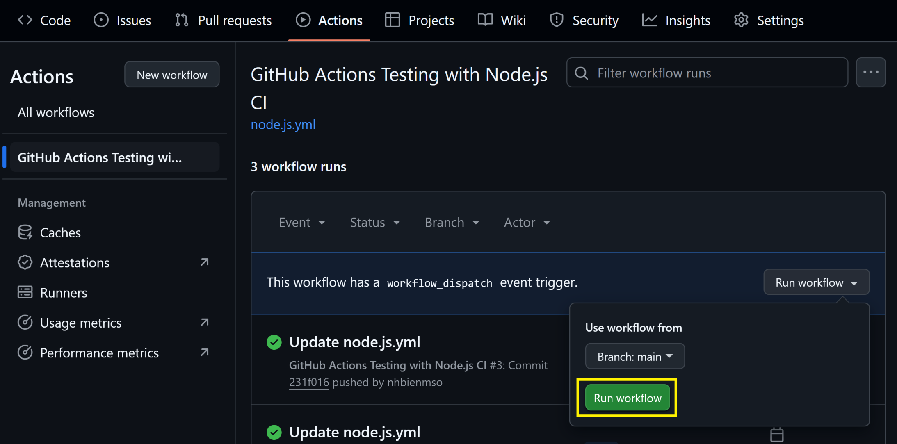
2. Run the Workflow Manually

Slide 14
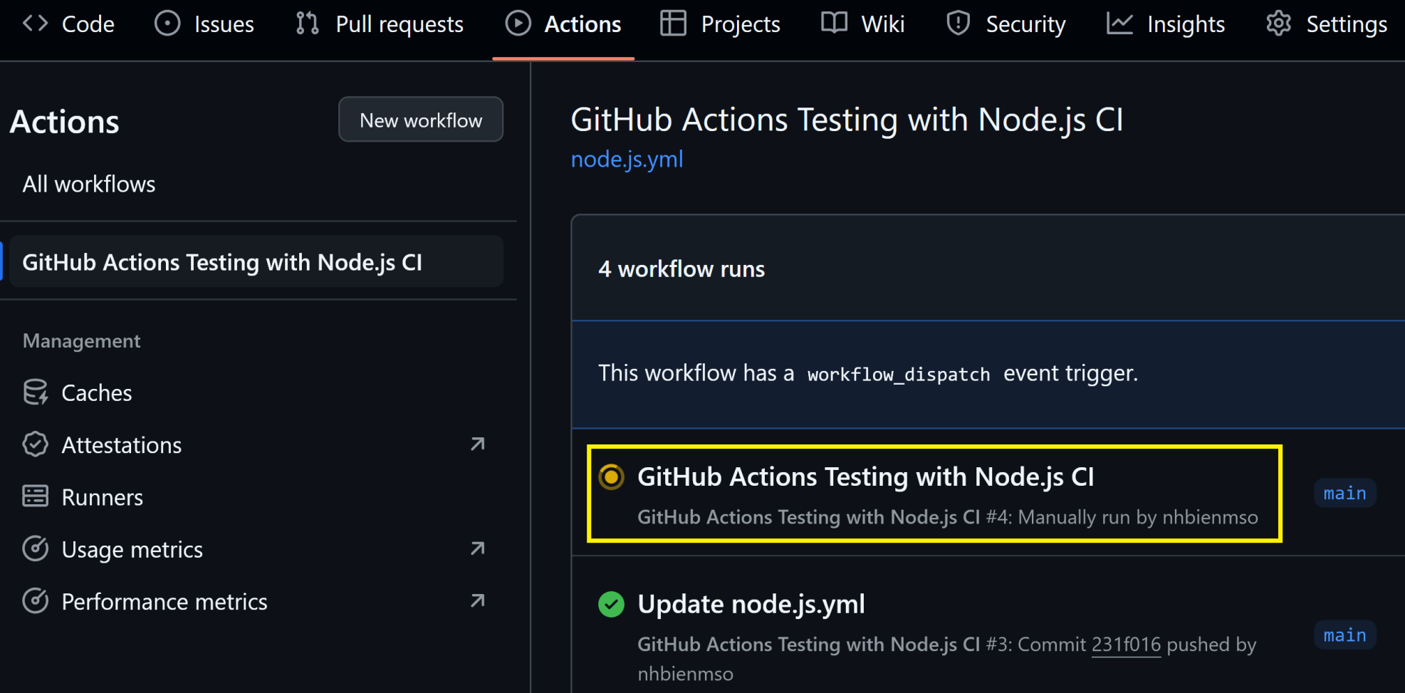
3. Review the Manual Run

Slide 16
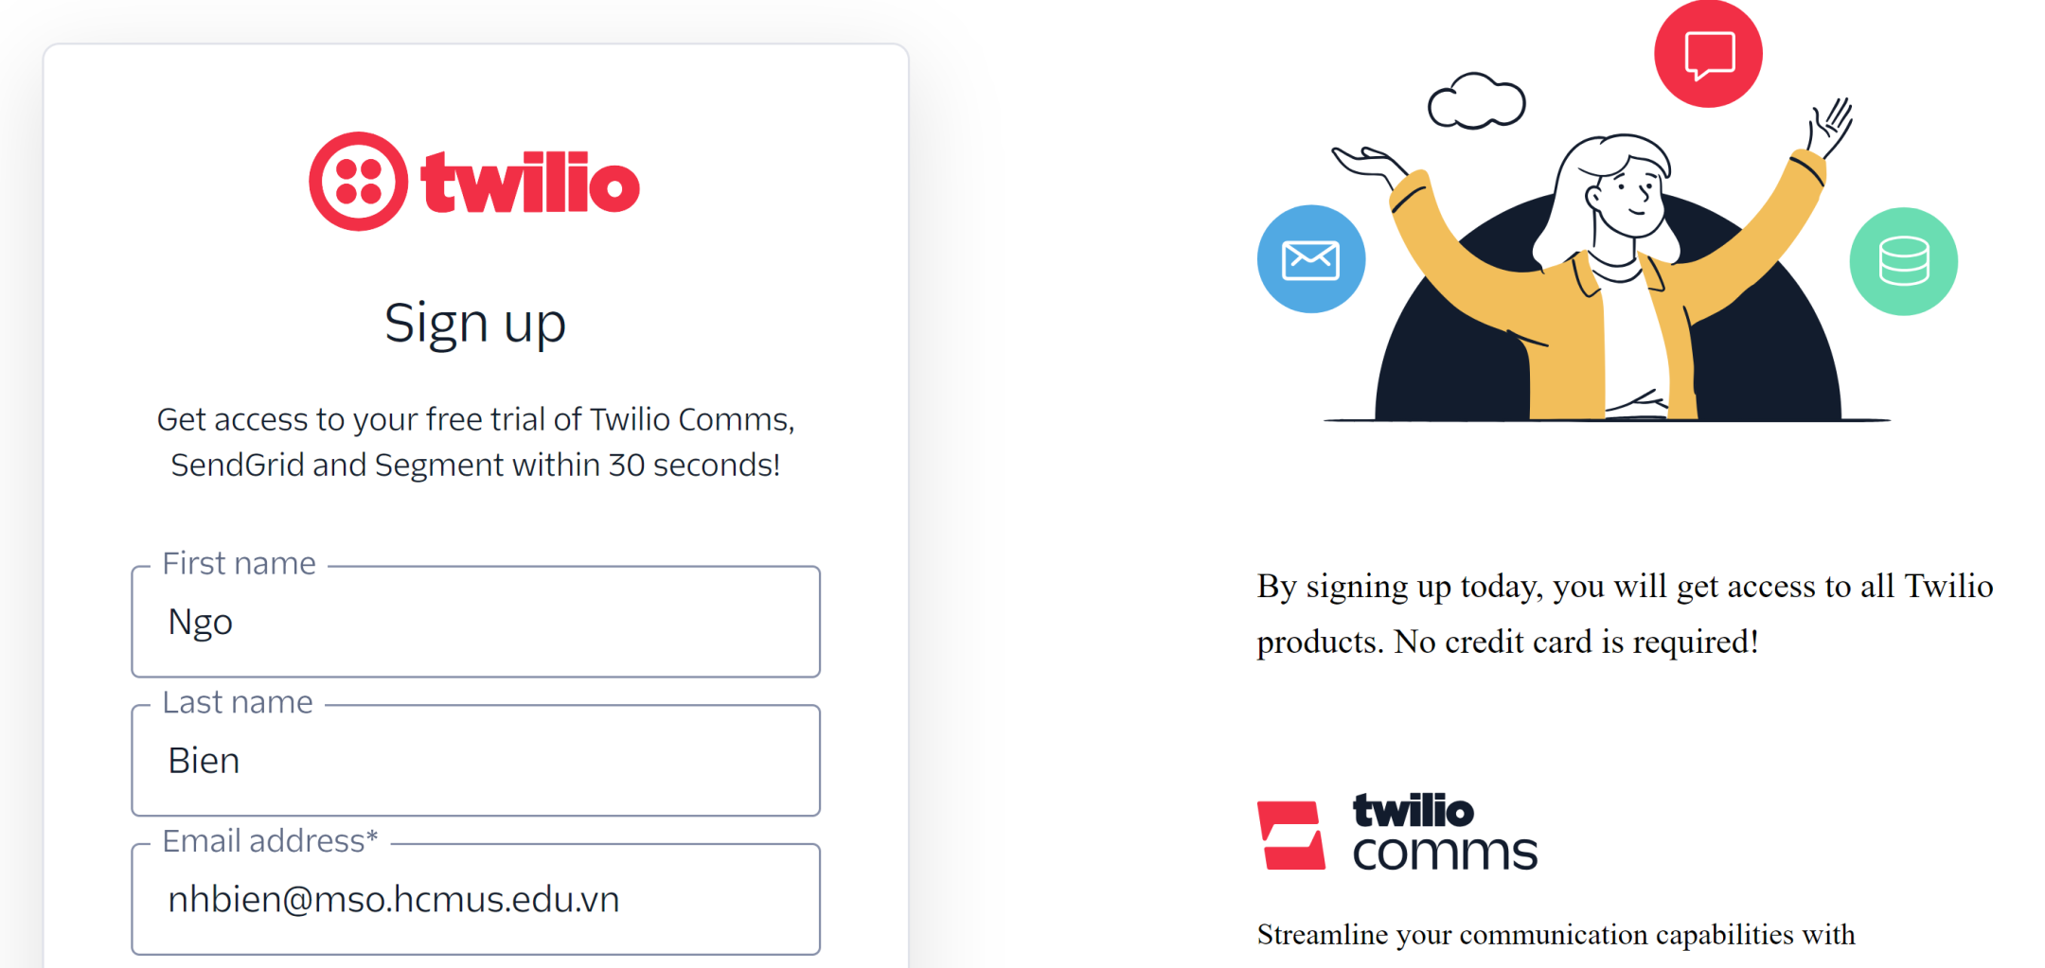
1. Register SendGrid Account
https://www.twilio.com/try-twilio
Follow all the instructions for activation and configurations.

Slide 17
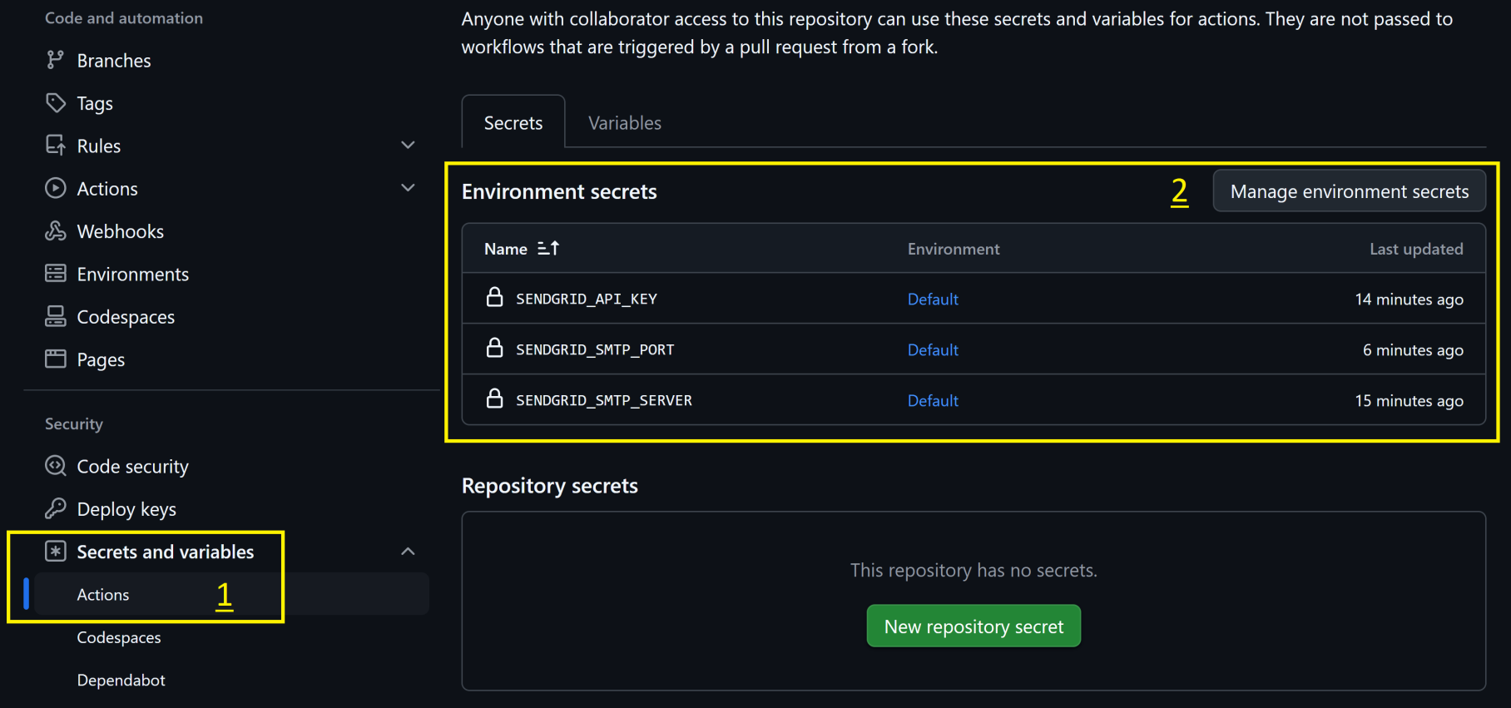
2. Create GitHub Actions Secrets

Slide 18
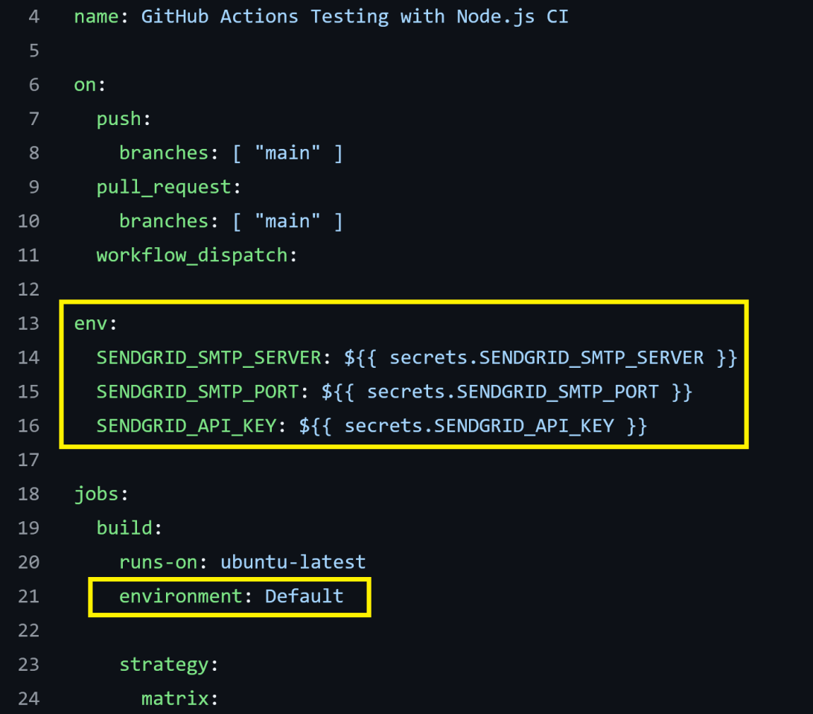
3. Retrieve Secrets

Slide 19
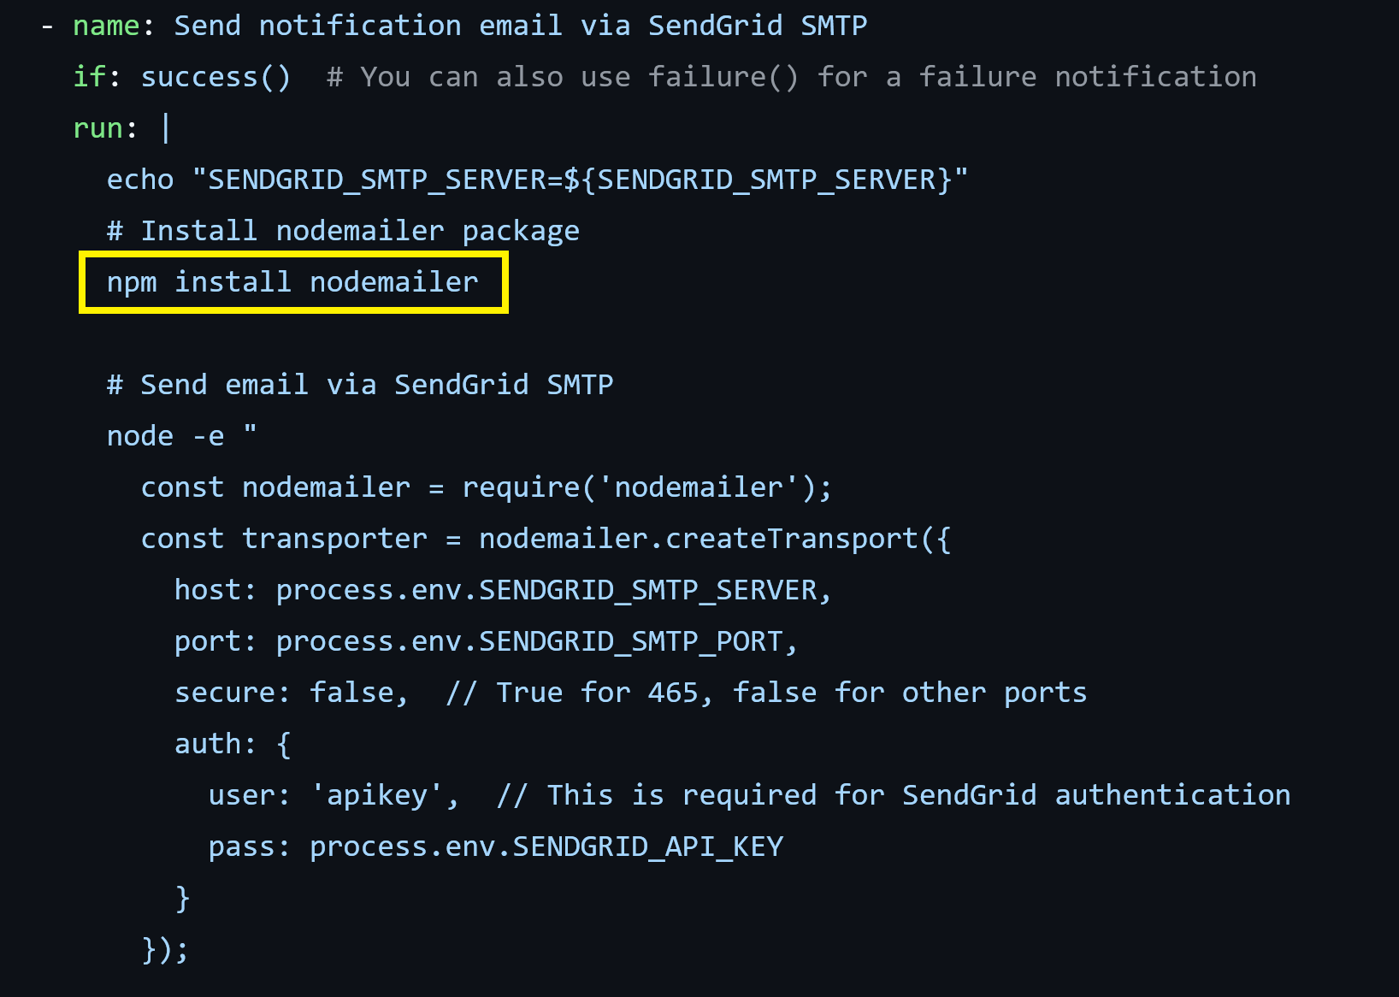
4. Send Emails

Slide 20

Further Reading
Michael Kaufmann at al. (2025). GitHub Actions in Action. Manning Publications.

Slide 21

Thank You & See You Again

